Slide 1

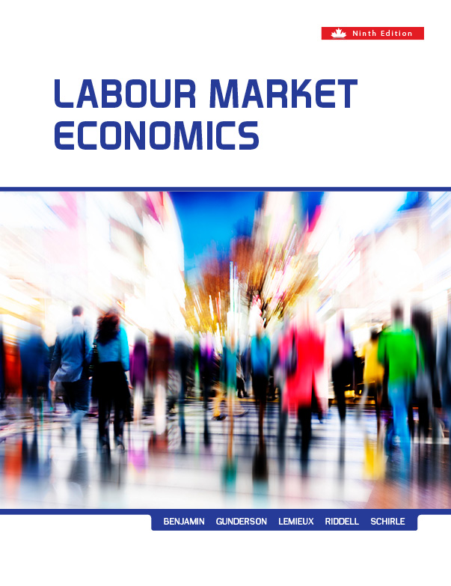
Chapter Fourteen
Unions and
Collective Bargaining
Prepared by Dr. Mir Ahasan Kabir
York University

Slide 2
Learning Objectives
Explain the nature of unions and the role they play in the labour market.
Summarize key measures of union influence in Canada
Describe the legal framework governing unions and collective bargaining and how it has evolved.
Use economic models to explain why some workers are more likely to be unionized than others and why unions are more prevalent in some industries, occupations, regions, and countries than in others.
Describe the key factors that determine union objectives and the constraints that unions face in trying to achieve their goals.
Explain and apply economic models that seek to explain how wages and employment are determined in unionized enterprises.
© 2021 MCGRAW-HILL EDUCATION LTD.
14 - <number>

Slide 3
Main Questions
What fraction of Canadian workers are members of unions? How has this evolved over time? How does this differ from other countries?
Which types of workers are most likely to be covered by union contracts?
What factors determine the level of unionization in the labour market?
What motives underlie union behaviour? How, for example, do unions evaluate the trade-off between higher wages and improved job security?
© 2021 MCGRAW-HILL EDUCATION LTD.
14 - <number>

Slide 4
Main Questions
Can union behaviour be well represented by a purely economic model?
How do firms and unions interact in the setting of employment and wages?
Can economic theory account for apparently inefficient union practices like “featherbedding” and other restrictions placed on firm employment decisions?
How can we incorporate “bargaining power” into a model of firm–union interaction?
© 2021 MCGRAW-HILL EDUCATION LTD.
14 - <number>

Slide 5
Unions and Collective Bargaining in Canada
Unions
Are collective organizations whose primary objective is to improve the well-being of their members
The objective is met though collective bargaining and the outcome is an agreement specifying:
  Wages
  Benefits
  Aspects of employment relations
© 2021 MCGRAW-HILL EDUCATION LTD.
14 - <number>

Slide 6
Unions and Collective Bargaining in Canada
There are two basic types of unions:
Craft Unions which represent workers in a particular trade or occupation such as printing and construction
Industrial Unions which represent all workers in a particular industry regardless of occupation such as automobile, steel, and forest industries
© 2021 MCGRAW-HILL EDUCATION LTD.
14 - <number>

Slide 7
Unions and Collective Bargaining in Canada
Unions’ additional roles:
Social and political affairs
Influence the Government in power
Provide financial support to the dominant parties
© 2021 MCGRAW-HILL EDUCATION LTD.
14 - <number>

Slide 8
Unions and Collective Bargaining in Canada
Table 14.1 Union Membership and Union Density in Canada, 1920–2019
Year | Union Membership (000s) | Union Membership as a Percentage of Civilian Labour Force | Union Membership as a Percentage of Non-agricultural Paid Workers
1920 | 374 | 9.4 | 16.0
1925 | 271 | 7.6 | 14.4
1930 | 322 | 7.9 | 13.9
1935 | 281 | 6.4 | 14.5
1940 | 362 | 7.9 | 16.3
1945 | 711 | 15.7 | 24.2
1951* | 1,029 | 19.7 | 28.4
1955 | 1,268 | 23.6 | 33.7
1960 | 1,459 | 23.5 | 32.3
1965 | 1,589 | 23.2 | 29.7
1970 | 2,173 | 27.2 | 33.6
1975 | 2,884 | 29.9 | 35.6
1980 | 3,397 | 29.2 | 35.7
1985 | 3,666 | 28.3 | 36.4
1990 | 4,031 | 28.5 | 34.5
1995 | 4,003 | 27.0 | 34.3
2000 | 4,013 | 25.3 | 32.6
2005 | 4,369 | 25.2 | 32.3
2010 | 4,487 | 24.3 | 31.6
2015 | 4,658 | 24.1 | 30.8
2019 | 4,892 | 24.2 | 30.4
© 2021 MCGRAW-HILL EDUCATION LTD.
14 - <number>

Slide 9
The Legal Framework
The evolution of the Unions legal framework in Canada
Prior to Confederation the law has discouraged collective bargaining
In the 1870s the law was “neutral” to collective bargaining
In 1944 the law encouraged the spread of collective bargaining
© 2021 MCGRAW-HILL EDUCATION LTD.
14 - <number>

Slide 10
The Legal Framework
Features of Canadian labour relations policy:
Workers have the right to join and form unions
Collective bargaining rights are protected under unfair labour practices legislation
System that defines bargaining representation is successfully established
Union is an exclusive bargaining representative of the workers
The rights are enforced by a labour relations board
© 2021 MCGRAW-HILL EDUCATION LTD.
14 - <number>

Slide 11
Factors Influencing Union Growth and Incidence
The main measures of the extent of unionization:
Union Density which defines the union membership as a percentage of paid workers (about 34% in Canada)
Collective Agreement Coverage which is the percentage of paid workers whose wages and working conditions are covered by a collective agreement (also about 34% in Canada)
© 2021 MCGRAW-HILL EDUCATION LTD.
14 - <number>

Slide 12
Factors Influencing Union Growth and Incidence
Table 14.2 Union Density and Collective Agreement Coverage in Selected OECD Countries
 | Union Membership as a Percentage of Paid Workers |  | Collective Agreement Coverage as a Percentage of Paid Workers
 | 1980 | 2016 | 1980 | 2016
Australia | 50 | 14 | 84 | 60
Canada | 34 | 29 | 37 | 28
Denmark | 79 | 67 | 82 | 82
France | 20 | 8 | 70 | 99
Germany | 35 | 17 | 85 | 56
Italy | 50 | 34 | 80 | 80
Japan | 31 | 17 | 31 | 17
Netherlands | 35 | 17 | 77 | 79
New Zealand | 69 | 18 | 70 | 15
Sweden | 78 | 62 | 88 | 90
United Kingdom | 52 | 24 | 69 | 26
United States | 22 | 10 | 25 | 12
© 2021 MCGRAW-HILL EDUCATION LTD.
14 - <number>

Slide 13
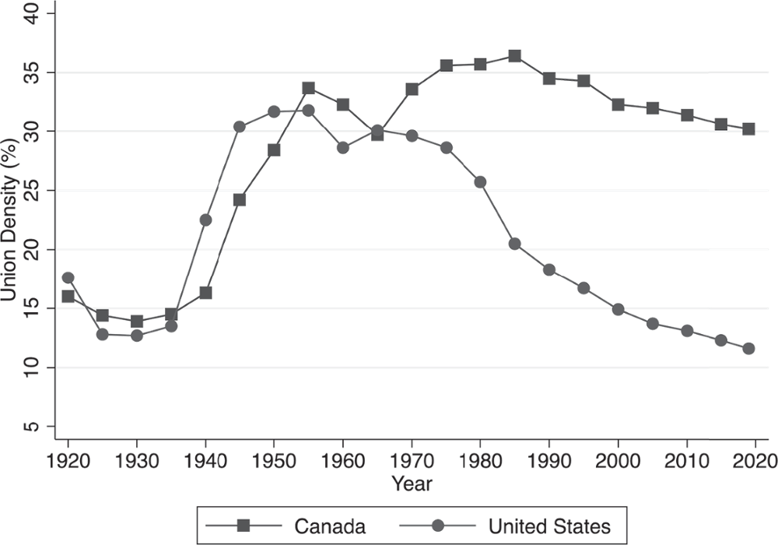
Factors Influencing Union Growth and Incidence
Figure 14.1 Union Density in Canada and the United States, 1920–2019
© 2021 MCGRAW-HILL EDUCATION LTD.
14 - <number>

Slide 14
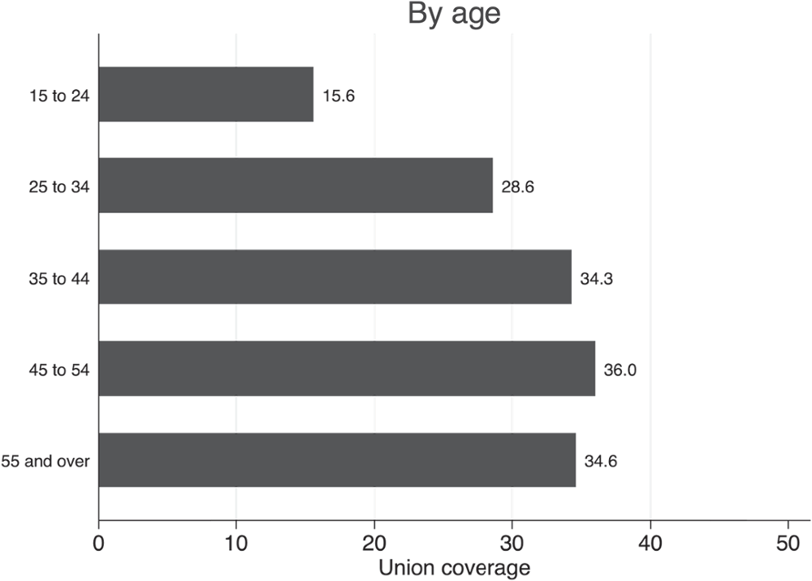
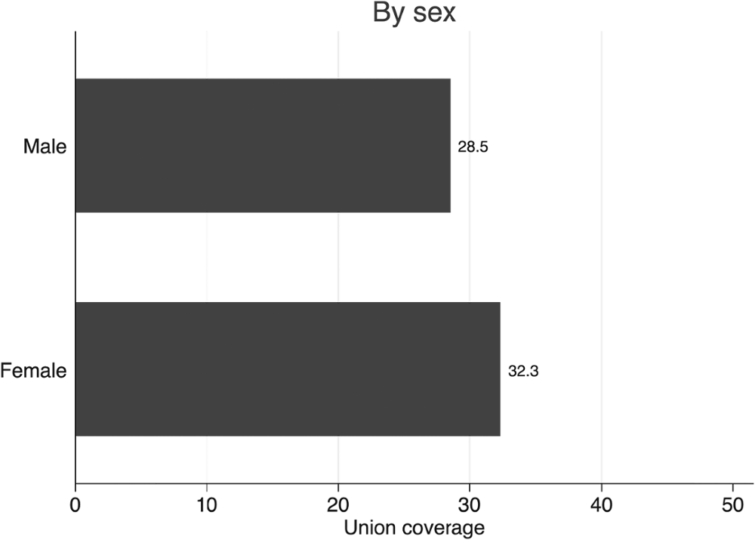
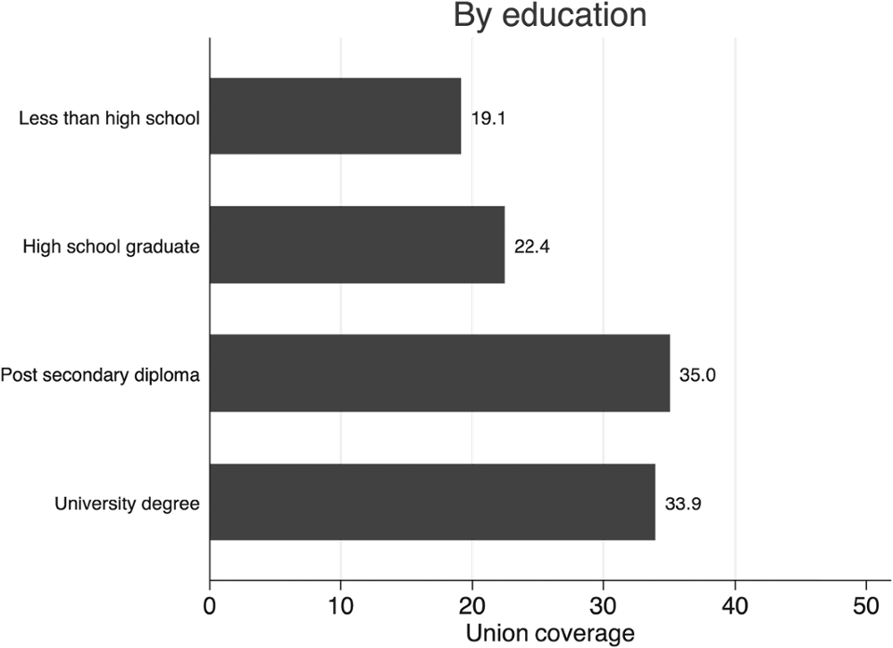
Factors Influencing Union Growth and Incidence
Figure 14.2 Percentage of paid workers covered by a union contract, by various characteristics
© 2021 MCGRAW-HILL EDUCATION LTD.
14 - <number>

Slide 15
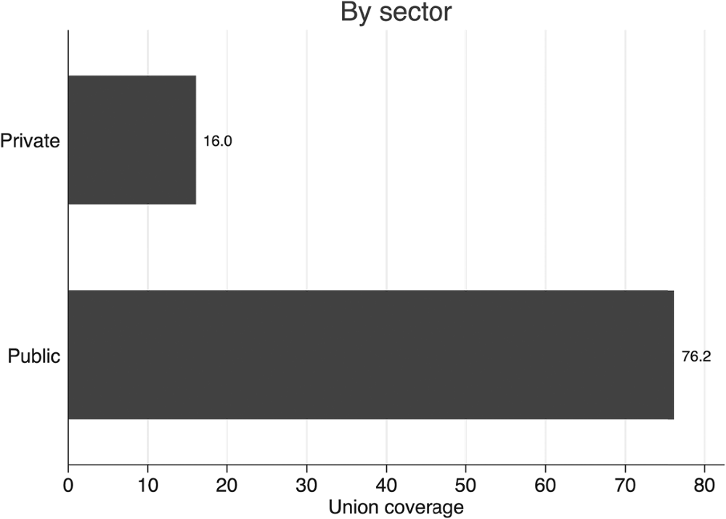
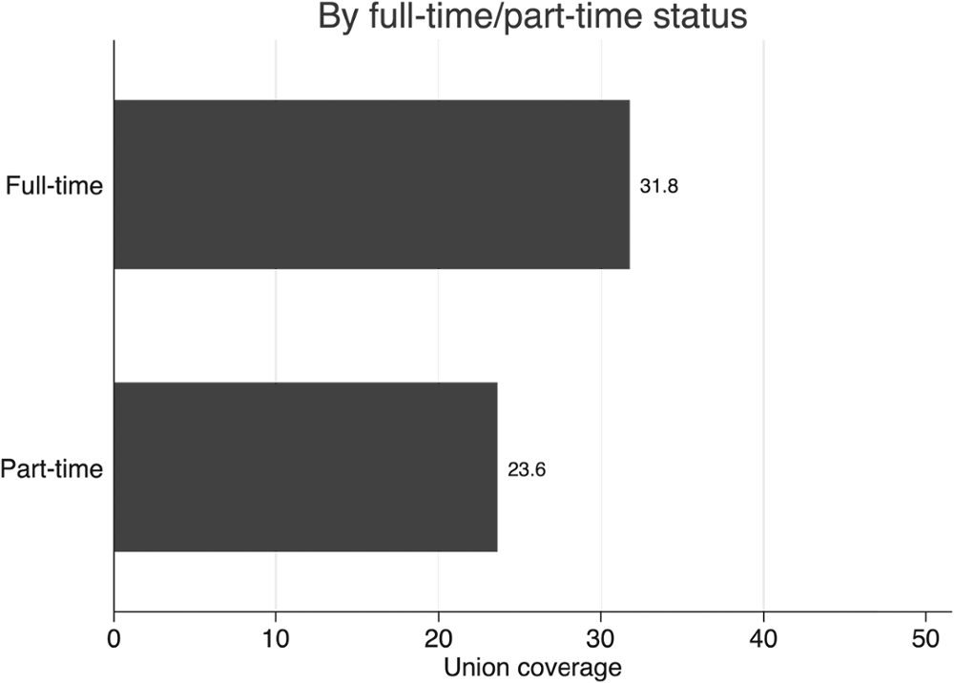
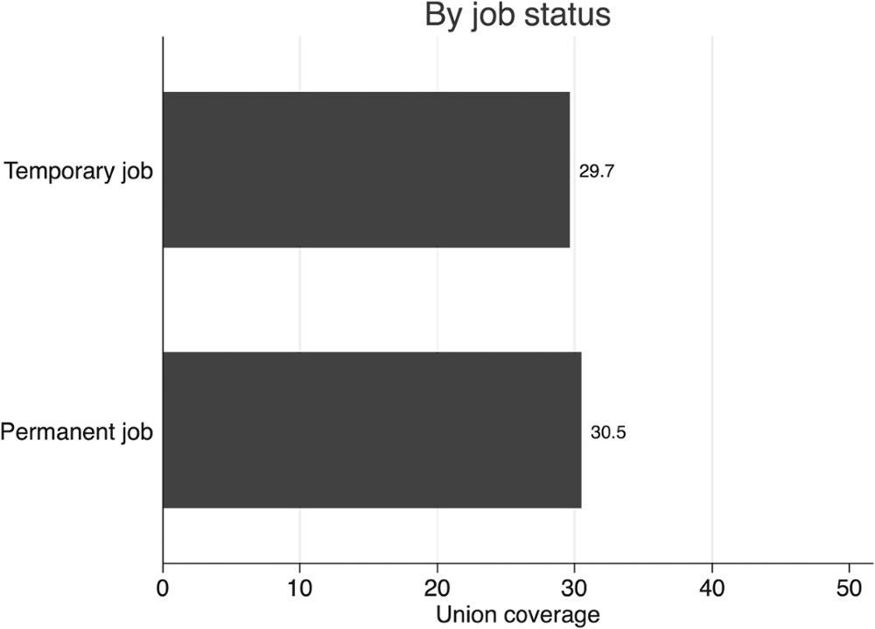
Factors Influencing Union Growth and Incidence
Figure 14.2 Percentage of paid workers covered by a union contract, by various characteristics
© 2021 MCGRAW-HILL EDUCATION LTD.
14 - <number>

Slide 16
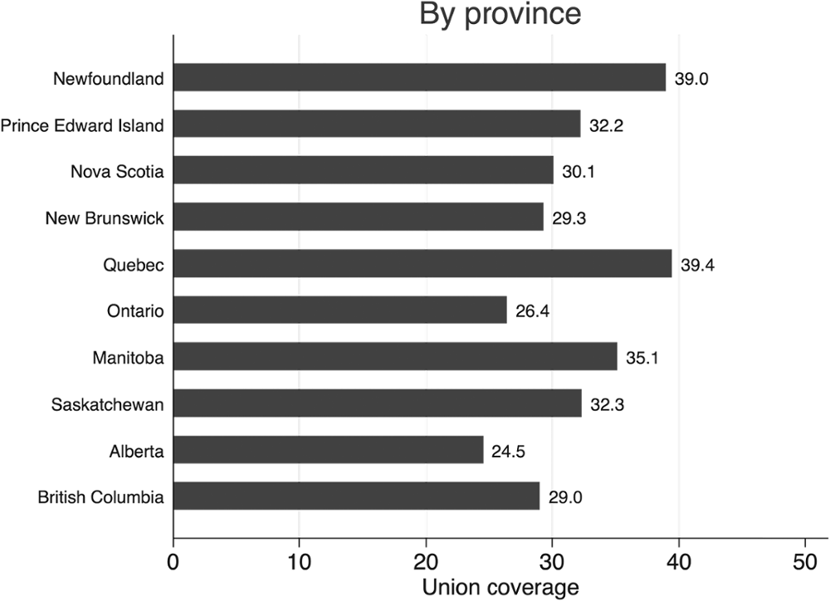
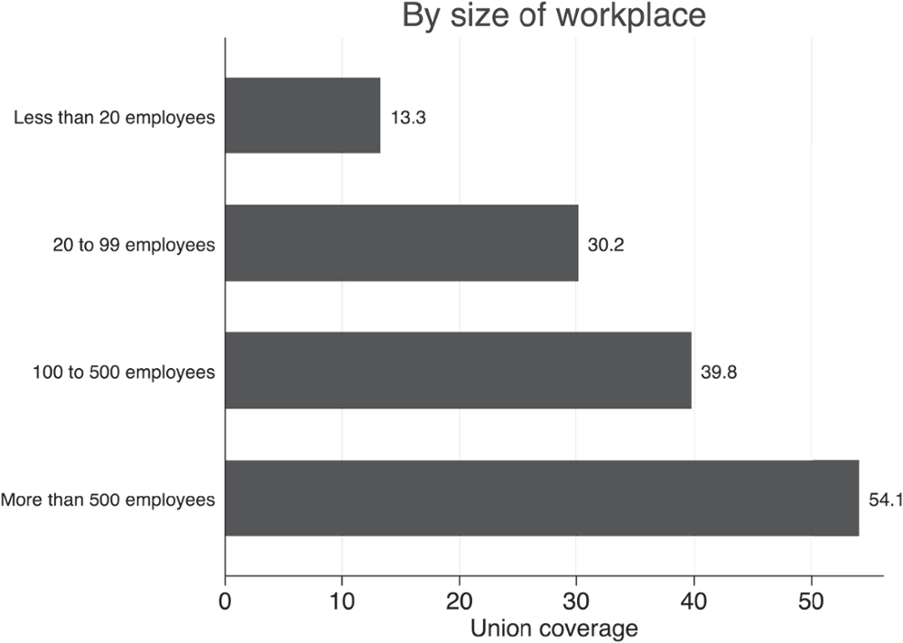
Factors Influencing Union Growth and Incidence
Figure 14.2 Percentage of paid workers covered by a union contract, by various characteristics
© 2021 MCGRAW-HILL EDUCATION LTD.
14 - <number>

Slide 17
Factors Influencing Union Growth and Incidence
The union is an exclusive bargaining representative for all employees in the bargaining unit
The extent of union organization in Canada varies considerably by industry, occupation, region and various individual employee or employer characteristics
Unionization is highest in nursing and blue-collar occupations
Industry differences are also substantial and public sector employees form unions more often
Full-time workers and workers above 40 are more likely to be unionized
© 2021 MCGRAW-HILL EDUCATION LTD.
14 - <number>

Slide 18
Factors Influencing Union Growth and Incidence
Using demand and supply framework
Demand for union representation depends on the expected benefits and costs of union representation
The supply of union representation depends on the contract administration activities from union leaders and staff
© 2021 MCGRAW-HILL EDUCATION LTD.
14 - <number>

Slide 19
Factors Influencing Union Growth and Incidence
Demand for Union Representation
Benefits:
Higher wages
Nonwage benefits
Greater employment security
Protection from arbitrary treatment by management
Costs:
Union dues
Time
Potential loss of income
© 2021 MCGRAW-HILL EDUCATION LTD.
14 - <number>

Slide 20
Factors Influencing Union Growth and Incidence
Supply for Union Representation
Supply side effects:
Administering contracts (costly)
Reallocation of resources to yield higher return
Organizing new workplace activities (depends on a number of factors)
© 2021 MCGRAW-HILL EDUCATION LTD.
14 - <number>

Slide 21
Factors Influencing Union Growth and Incidence
The extent of unionization depends on choices made by:
    Employees
    Organizational and Contract Administration activities of union leaders
    Actions of the employers
The supply of union organizational and contract administration effort will be high where the per worker cost of organization and representation is low
© 2021 MCGRAW-HILL EDUCATION LTD.
14 - <number>

Slide 22
Empirical Evidence
Riddell (1993) , Farber (1983), and Lipset and Meltz (2004) explored the differences in Canadian U.S. unionization rates and discovered that:
  The differences in rates can be attributed to differences in supply
  The overall desire for unionization is similar in both countries
© 2021 MCGRAW-HILL EDUCATION LTD.
14 - <number>

Slide 23
Empirical Evidence
Factors influencing the demand and supply for unions:
Social attitudes towards unions
The legislative framework governing unionization
Other economic and social legislation
Aggregate economic conditions
© 2021 MCGRAW-HILL EDUCATION LTD.
14 - <number>

Slide 24
Empirical Evidence
Worked Example
Decomposing Changes in Unionization into Structural and Propensity to Unionize Components
 | Percentage of Employment of Paid Workers |  | Union Density
 | Base Period | Final Period | Base Period | Final Period
Goods-producing industries | 32 | 24 | 43 | 38
Services-producing industries | 68 | 76 | 26 | 32
All industries | 100 | 100 | 31 | 33
Union density in base period = .32 × 43% + .68 × 26% = 31.4%
Union density in final period= .24 × 38% + .76 × 32% = 33.4%
Between the base and final periods, union density changed by +2 percent.
© 2021 MCGRAW-HILL EDUCATION LTD.
14 - <number>

Slide 25
Empirical Evidence
Worked Example
Decomposing Changes in Unionization into Structural and Propensity to Unionize Components
 | Percentage of Employment of Paid Workers |  | Union Density
 | Base Period | Final Period | Base Period | Final Period
Goods-producing industries | 32 | 24 | 43 | 38
Services-producing industries | 68 | 76 | 26 | 32
All industries | 100 | 100 | 31 | 33
Counterfactual union density = .24 × 43% + .76 × 26% = 30.1%
Thus, the change in union density due to structural change in the composition of employment is 30.1 − 31.4 = − 1.3 percent.
© 2021 MCGRAW-HILL EDUCATION LTD.
14 - <number>

Slide 26
Empirical Evidence
Industry and Enterprise Characteristics
Unionization higher in:
  Larger firms
  Concentrated industries
  Capital-intensive production processes
  Hazardous jobs
© 2021 MCGRAW-HILL EDUCATION LTD.
14 - <number>

Slide 27
Empirical Evidence
Industry and Enterprise Characteristics
Possible causes of higher union concentration in larger firms:
In larger organizations individual action is less effective
Per-worker cost of union organization is lower
Increase in potential gain from unions for the workers
© 2021 MCGRAW-HILL EDUCATION LTD.
14 - <number>

Slide 28
Empirical Evidence
Personal Characteristics
Less union formation with part-timers
Women are less likely to be represented by a union
Increase in potential gain from unions in blue collar jobs
Decrease in union formation with age
Low paying workers tend to be more interested in union formation
© 2021 MCGRAW-HILL EDUCATION LTD.
14 - <number>

Slide 29
Theory of Union Behaviour
Main Objectives:
  Wages
  Employment of union members
  The goals of the organization itself
Factors Influencing Objectives:
  Price level
  Cost of living
  Alternative wage
  Employment
© 2021 MCGRAW-HILL EDUCATION LTD.
14 - <number>

Slide 30
Union Objectives
Utility is a positive function of wage rate and employment
Indifference curve is downward sloping
  Higher wage is needed to compensate for lower employment
Curves have a convex shape
  Diminishing marginal rate of substitution
© 2021 MCGRAW-HILL EDUCATION LTD.
14 - <number>

Slide 31
Union Objectives
Union Constraints: Demand for Labour
Wage negotiation/market determined employment
Unions negotiate wages considering the consequences
The firm decides the employment level
Maximizing profits according to DL curve
DL curve is analogous to a budget constraint
Equilibrium is the tangent of the iso-utility curve and DL curve
© 2021 MCGRAW-HILL EDUCATION LTD.
14 - <number>

Slide 32
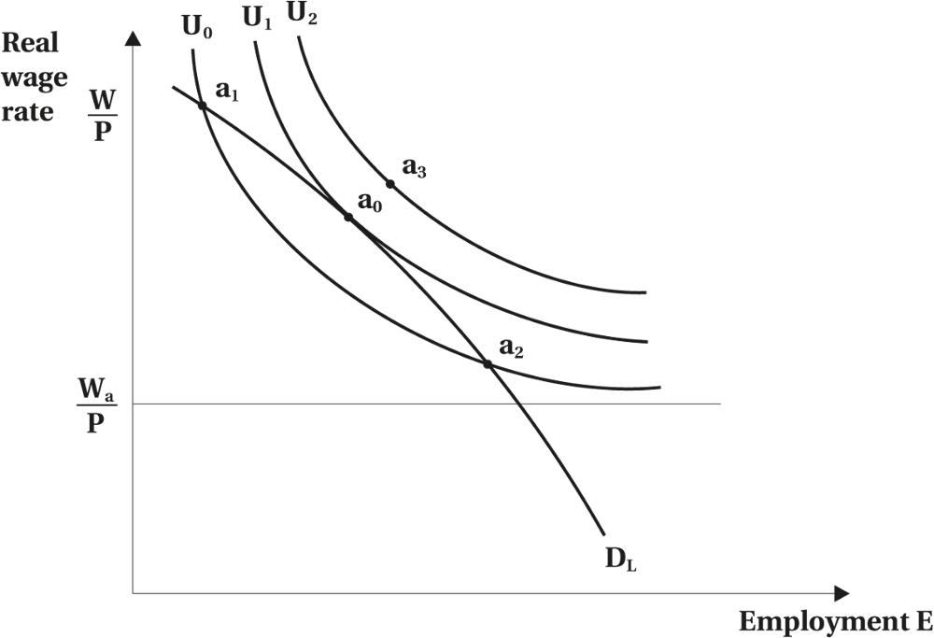
Union Objectives
Figure 14.3 Union Objectives and Constraints
© 2021 MCGRAW-HILL EDUCATION LTD.
14 - <number>

Slide 33
Special Cases
Alternative objective functions have been suggested to describe union behaviour:
  Maximize Wage Rate: Horizontal straight lines
  Maximize Employment E: Vertical straight lines
  Maximize Real Wage Bill: Rectangular hyperbolas where union attaches weight to both wages and employment
  Maximize Real Economic Rent: Rectangular hyperbolas with respect to the origin
© 2021 MCGRAW-HILL EDUCATION LTD.
14 - <number>

Slide 34
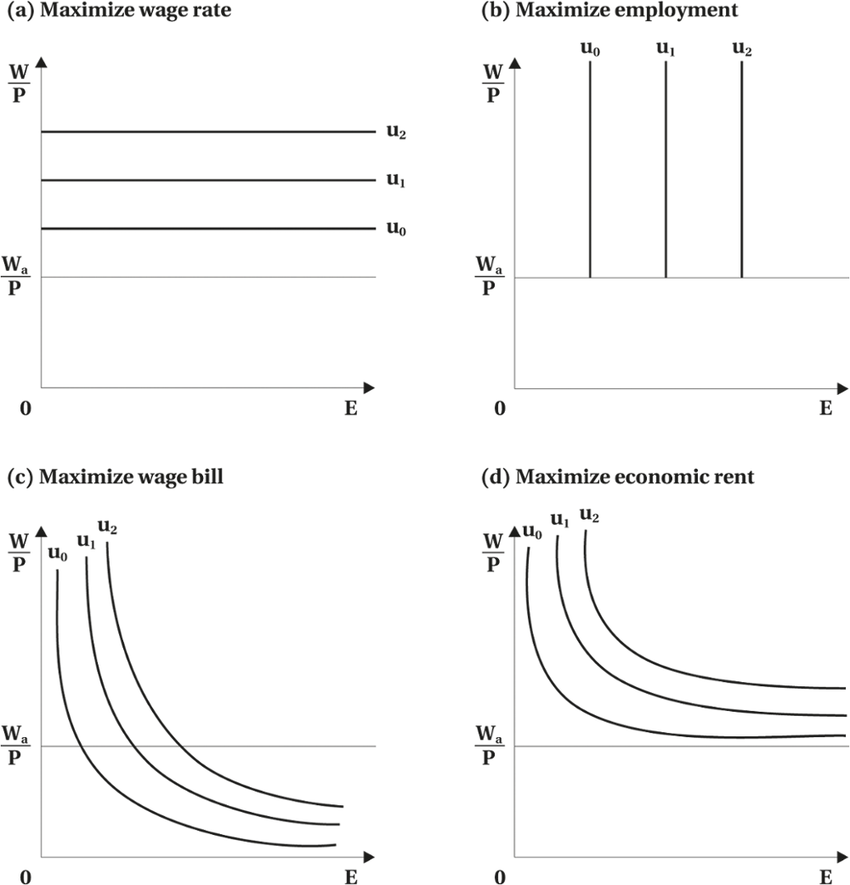
Special Cases
Figure 14.4 Union Objectives: Some Special Cases
© 2021 MCGRAW-HILL EDUCATION LTD.
14 - <number>

Slide 35
Union Preferences:
Some Additional Considerations
Heterogeneous Preferences
Skills
Personal Characteristics such as: age, seniority, etc.
The median voter model does not apply precisely in the union setting since:
    Unions do not choose among alternatives by conducting a sequence of pair-wise votes
    Most choices are made by union leaders
    Union leaders face tradeoffs among several alternatives
© 2021 MCGRAW-HILL EDUCATION LTD.
14 - <number>

Slide 36
Union Preferences:
Some Additional Considerations
Union Leaders versus Union Members
Unions do not make choices in a fully democratic fashion
Leaders are elected to implement policy
Leaders have greater access to information
Union membership and union objective
Changes to membership alter union preferences
In rapidly expanding firm median voter theorem will fail
© 2021 MCGRAW-HILL EDUCATION LTD.
14 - <number>

Slide 37
Union Constraints
Union must negotiate with the firm
Union must consider the consequences of its decisions
The firm chooses employment level where profits are maximized
© 2021 MCGRAW-HILL EDUCATION LTD.
14 - <number>

Slide 38
Union Constraints
Firm’s Isoprofit Curves
The curves are combinations of wage rates and employment rates that yield equal profits
Lower curves imply higher profits
Maximum is attained where the isoprofit and labour curves intersect at the maximum of isoprofit curve
With increasing employment, profit must decrease for a given wage rate
With higher wage profit falls for a given employment
© 2021 MCGRAW-HILL EDUCATION LTD.
14 - <number>

Slide 39
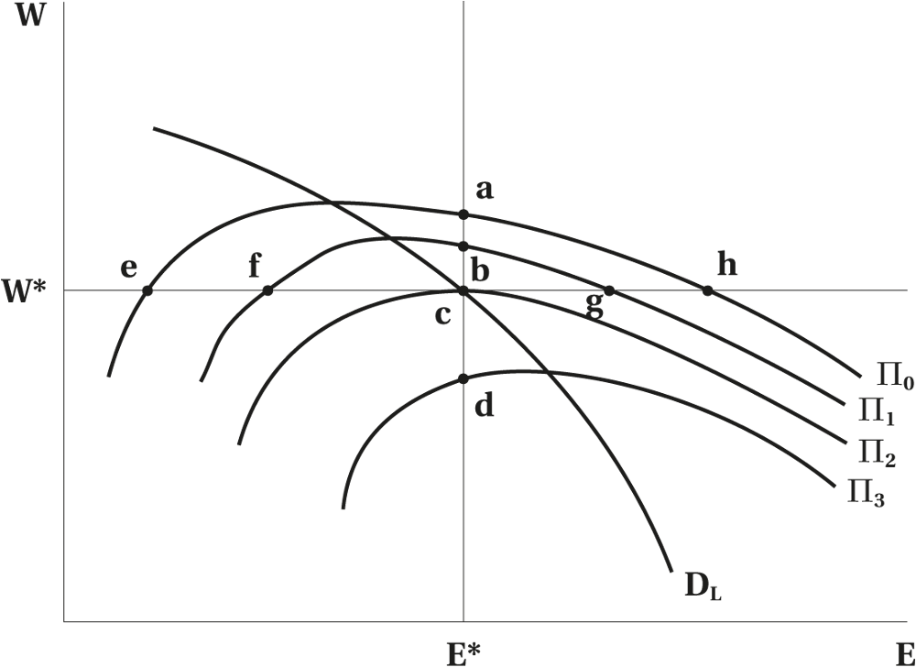
Union Constraints
Figure 14.5 The Firm’s Isoprofit Curves
© 2021 MCGRAW-HILL EDUCATION LTD.
14 - <number>

Slide 40
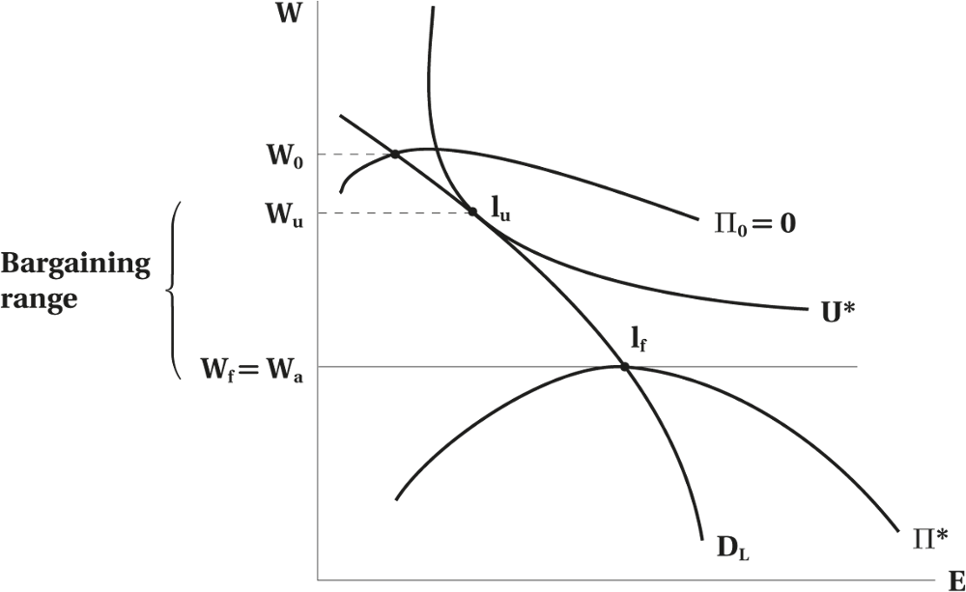
Union Constraints
Figure 14.6 The Firm’s and Union’s Preferred Wage-Employment Outcomes and the Bargaining Range
© 2021 MCGRAW-HILL EDUCATION LTD.
14 - <number>

Slide 41
Union Constraints
The Firm’s and Union’s Preferred Wage-Employment Outcomes
Firm cannot pay wages below alternative wage (Wa)
Firm prefers I_{f} and union I_{u}
Bargaining range in the interval W_{a} W_{u}
Wage rate will lie in the bargaining range
With level of employment determined by labour demand function
© 2021 MCGRAW-HILL EDUCATION LTD.
14 - <number>

Slide 42
Relaxing the Demand Constraint
Unions can alter the set of available options by altering the following constraints:
Making the demand for labour more inelastic
Alter the constraint of product market by supporting the quotas, tariffs, etc.
Opposition to regulations
Policies that focus on labour demand such as minimum wage laws or full employment policies
Limiting immigration
© 2021 MCGRAW-HILL EDUCATION LTD.
14 - <number>

Slide 43
Efficient Wage and Employment Contracts
Negotiating over wage and employment is mutually advantageous
Pareto-efficient wage-employment outcomes
  Union’s indifference curve tangent to the firms isoprofit curve
© 2021 MCGRAW-HILL EDUCATION LTD.
14 - <number>

Slide 44
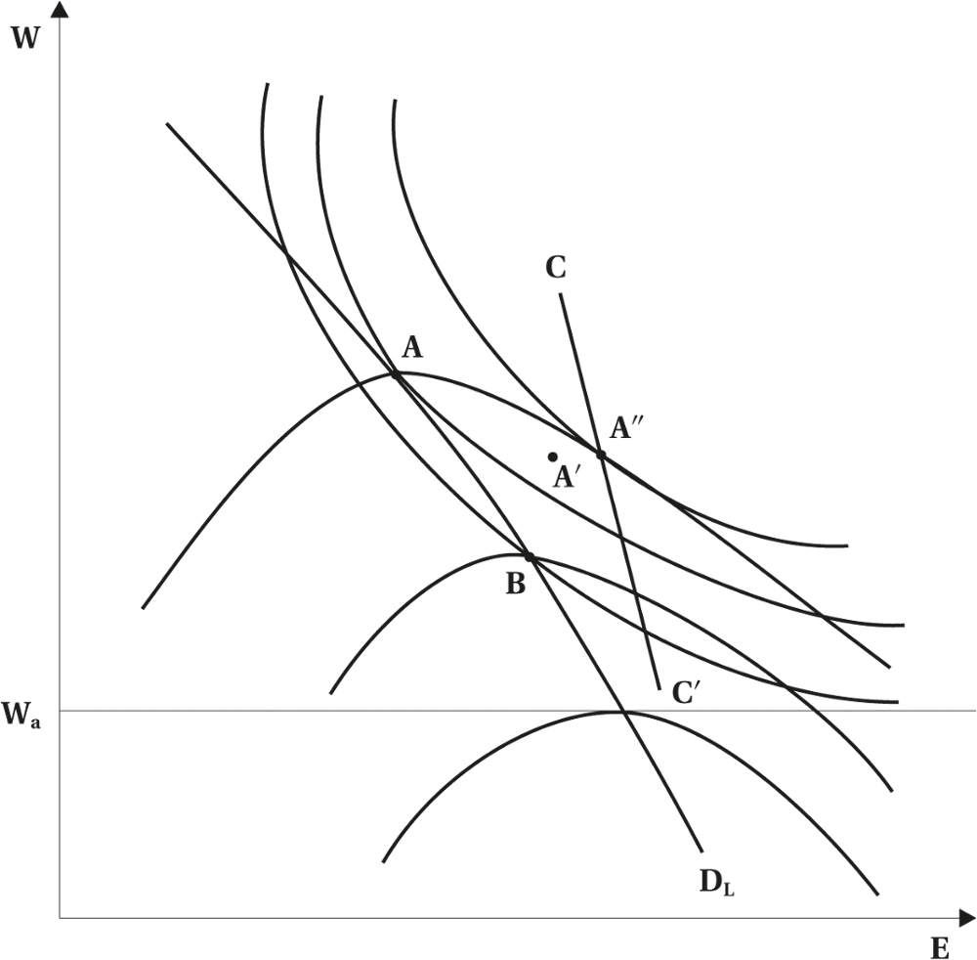
Efficient Wage and Employment Contracts
Figure 14.7 Efficient and Inefficient Wage-Employment Contracts
© 2021 MCGRAW-HILL EDUCATION LTD.
14 - <number>

Slide 45
Efficient Wage and Employment Contracts
The parties are better off in the shaded areas
A’’ is Pareto-efficient outcome
The outcome is where union indifference curve is tangent to the firm’s isoprofit curve
The locus of Pareto-efficient wage employment outcome is called the contract curve which is CC’
The contract curve must lie to the right of the labour demand curve
Moving up on the CC: unions are better off
Moving down on the CC: the firm is better off
© 2021 MCGRAW-HILL EDUCATION LTD.
14 - <number>

Slide 46
Efficient Wage and Employment Contracts
Obstacles to Reaching Efficient Contracts
Information needed may not be available
An agreement about employment difficult to enforce
Changes in the market and economic conditions or the employers’ financial viability.
Monitoring and enforcing efficient contracts are too costly in most settings
© 2021 MCGRAW-HILL EDUCATION LTD.
14 - <number>

Slide 47
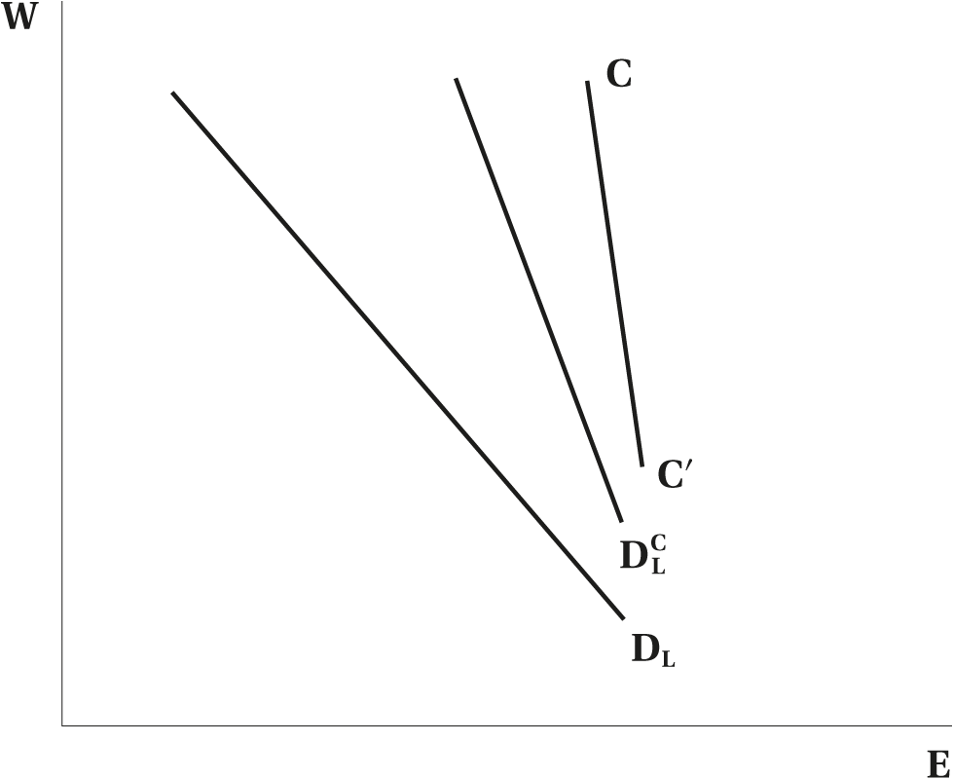
Efficient Wage and Employment Contracts
Figure 14.8 Inefficient, Approximately Efficient, and Efficient Contracts
© 2021 MCGRAW-HILL EDUCATION LTD.
14 - <number>

Slide 48
Efficient Wage and Employment Contracts
Efficient versus Inefficient Contracts
Two main models discussed:
  Labour Demand Curve Model: Involves two parties negotiating the wage rate and the firm setting the employment
  Efficient Contracts Model: Involves two parties negotiating on both the wage rate and the employment
© 2021 MCGRAW-HILL EDUCATION LTD.
14 - <number>

Slide 49
Empirical Application
Union has a dominant power and can determine the wage
Union places high weight on employment
Union’s preferences display diminishing marginal rate of substitution
Union preferences are sensitive to alternative wage
© 2021 MCGRAW-HILL EDUCATION LTD.
14 - <number>

Slide 50
Union Bargaining Power
Assuming that the two parties negotiate over wages alone
Union bargaining power related to the elasticity of labour demand:
  The more inelastic, the more power to raise the wage rates
Union bargaining power associated with the ability to raise wages
  Related to both the labour demand elasticity and the costs of disagreement to each party
© 2021 MCGRAW-HILL EDUCATION LTD.
14 - <number>

Slide 51
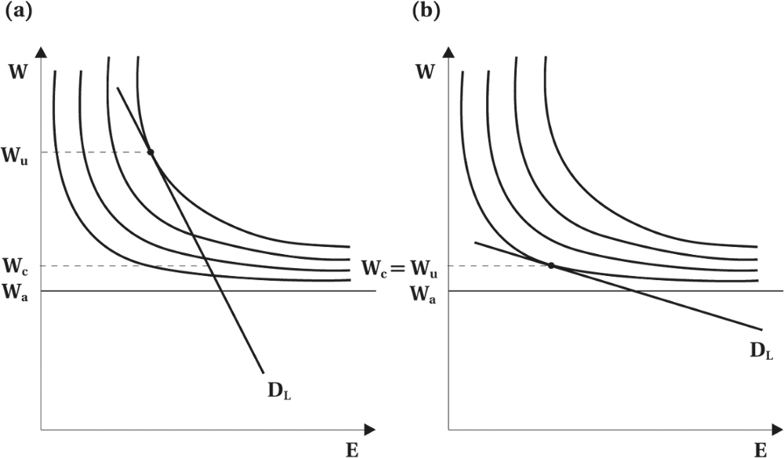
Union Bargaining Power
Figure 14.9 Alternative Aspects of Union Power
© 2021 MCGRAW-HILL EDUCATION LTD.
14 - <number>

Slide 52
Union Power and Labour Supply
Strike threat is the primary source of bargaining power
Restricting Supply: Craft Unions
Can raise wages artificially
Controlling entry to their craft
Try to control the whole trade
Set productivity related factors artificially high
Restricting Supply: Professional Associations
Have control over the process of occupational licensing and certification
The supply of labour to the occupation is restricted
The outcome is higher wage but lengthy education periods
© 2021 MCGRAW-HILL EDUCATION LTD.
14 - <number>

Slide 53
Chapter Summary
Definition: unions, objectives, and outcomes
Type of unions and the roles they play
Unions in Canada, their policy and features
Extensions of unions and their measures
Demand and supply analysis: costs vs. benefits
Empirical findings and their scope
© 2021 MCGRAW-HILL EDUCATION LTD.
14 - <number>

Slide 54
Chapter Summary
Union preferences, causes and related theorem
    A positive function of members’ wages and employment
    The effect of price levels and alternative wages
    Special cases
    Union leaders preferences vs. members preferences
Union constraints, outcomes and implications
    Labour demand and the firm profit
Efficient wage and obstacles
    Negotiation based on wage only
    Relaxing demand constraint: wage-employment negotiation
    Pareto-efficient contracts and approximately efficient contracts
Theory of bargaining and union bargaining power
© 2021 MCGRAW-HILL EDUCATION LTD.
14 - <number>

